Slide 1
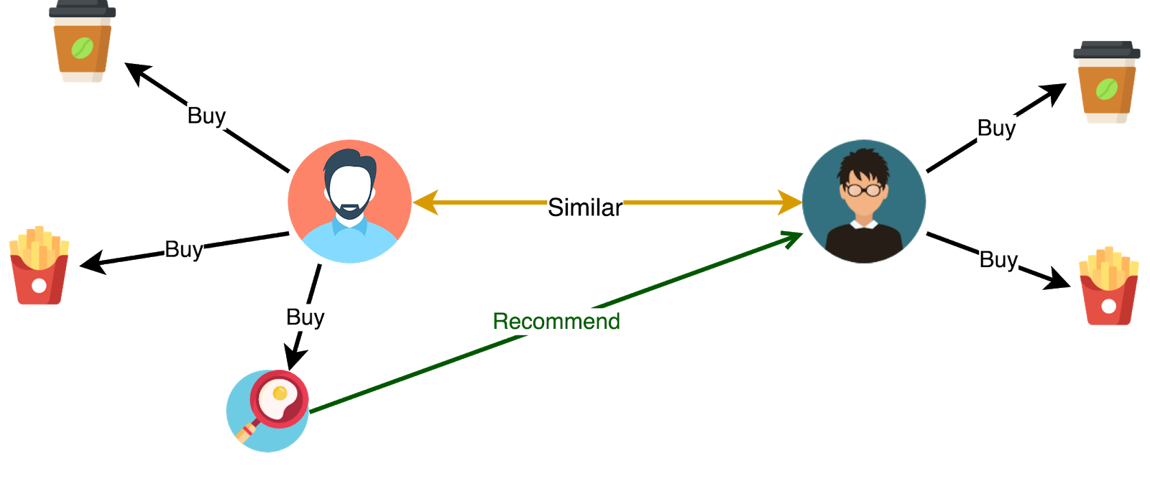
Restaurants recommendator
Mariloy Hernández, Jesus Antonio, Jesus Molina & Karla Plazas

Slide 2

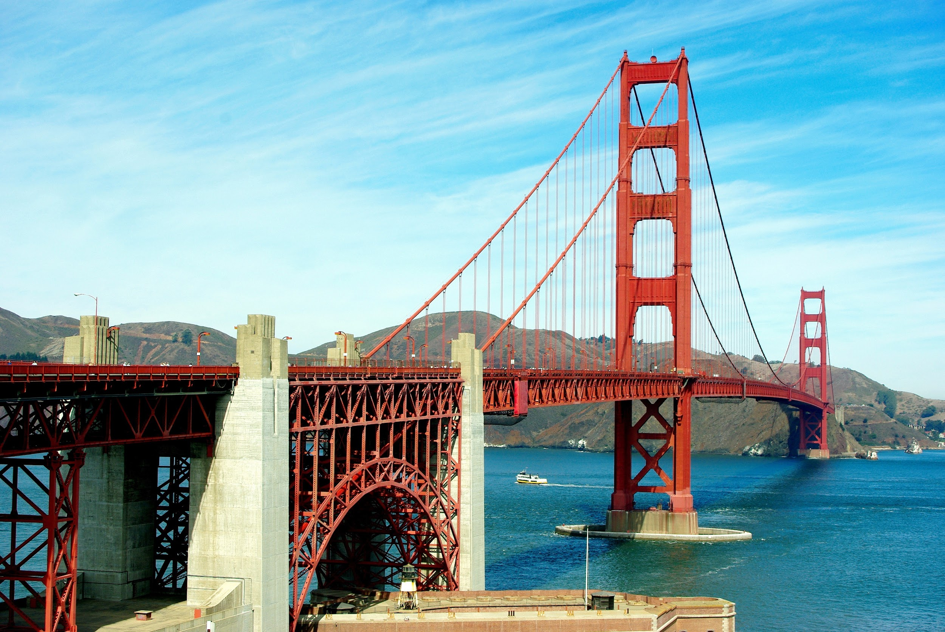



Slide 3


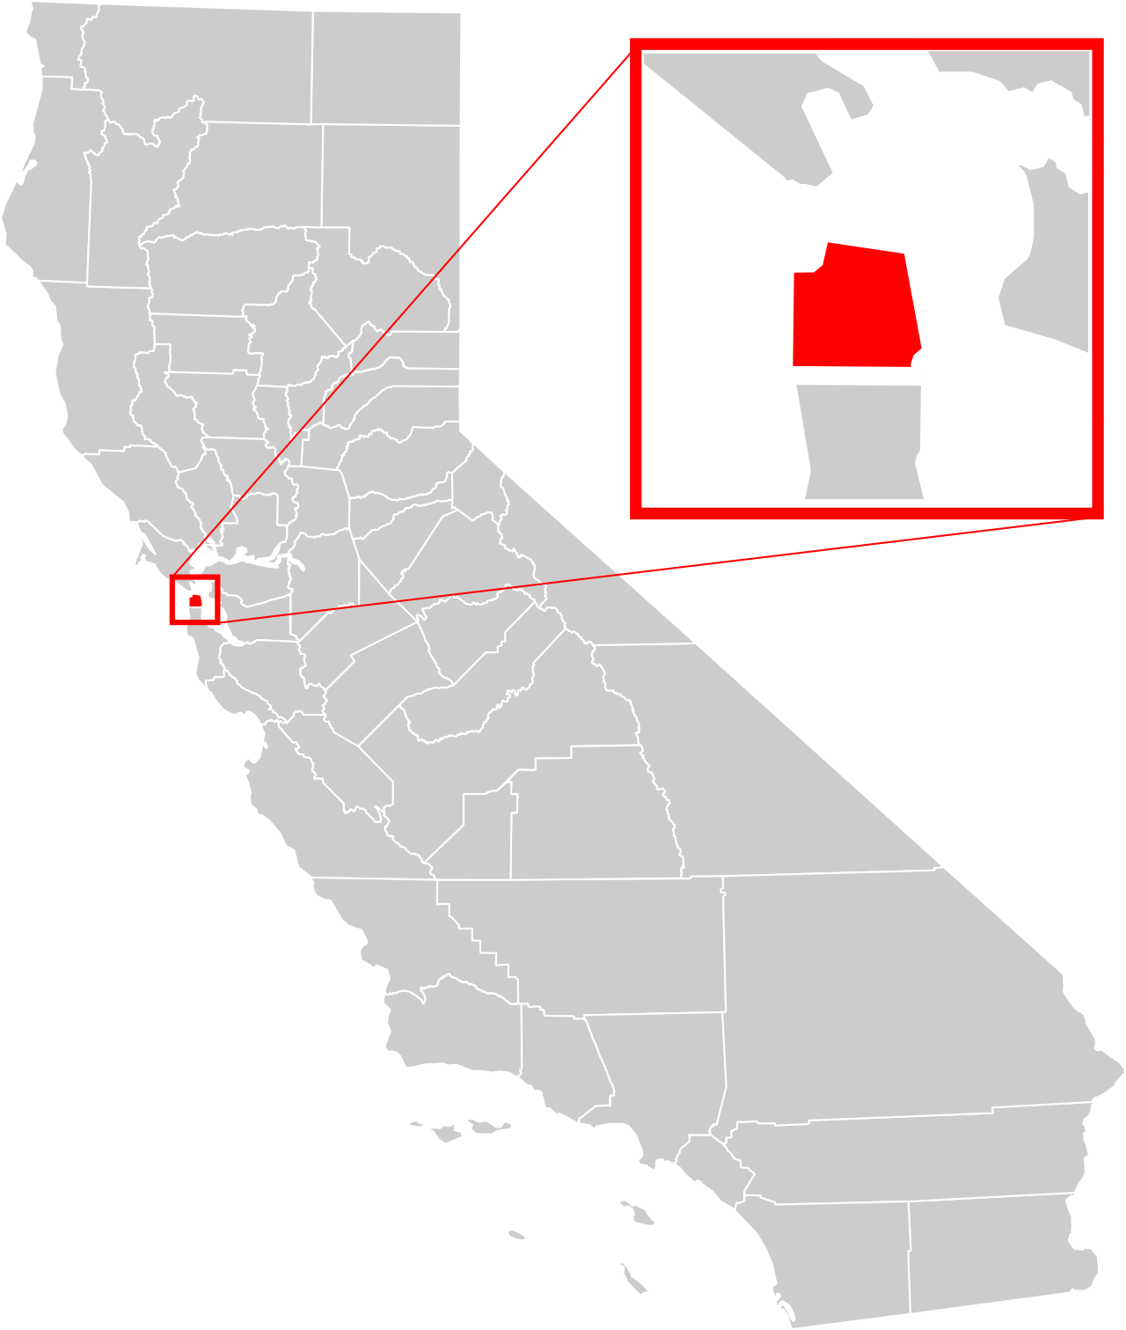

San Francisco
More than 4,300 restaurants
Time Restraint
Total area: 600.7km²
Too many options
Land: 121km², Water: 479.7km²
Location & Preferences
Tourism:
2019:around 26M
2022: 21M *Forecast*
What is the best option & the best route?

Slide 4

what questions do we want to solve

Slide 5
main questions
1
Can I obtain a recommendation of the best Restaurants near my location? (Lat & Long)
2
Can that recommendation be “real” and not have a bias from maybe the own restaurants?
3
Can that recommendation be streamlined based on important preferences to me and give me a route to visit them?

Slide 6

How Does the Restaurants Recommendator work?

Slide 7
Restaurants recommendator
1
2
3
Enter our web page, select the starting point and write 3 words of what you want to have in the restaurant
(example: romantic, view, outside).
Our model will select the best restaurants for you according to the starting point (close to you) and according with the 3 words you wrote.
Those restaurants will be mapped in the web page with the best route so you can have your whole day planned with your food for the day while you enjoy your vacations!

Slide 8
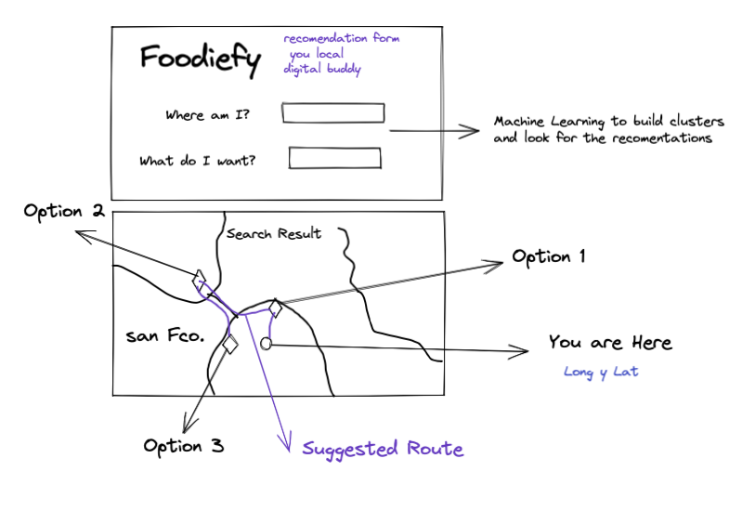
Restaurants recommendator

Slide 9

Data Source

Slide 10

data source

Slide 11

Machine Learning Model

Slide 12
ML Model
We will use K-Means cluster to predict which restaurant could be the user preference based on his location.
The prediction will be used to determine in which cluster a restaurant can be. Those clusters will be parametrized using, rating and number of reviews. To make the search we will input user location and based on it, best restaurants will be shown on the map.

Slide 13
ML Model
We will use a Matrix Factorization and Gradient Decent Optimization to predict a text input and build a recommendation to the user using a string based on his preferences.
We will use Yelp reviews to build the predictions

Slide 14
ML Mosdel
Collaborative Based Filtering

